Slide 1
Aerial/Satellite Imagery Retrieval
Vincent Tran
A20396585

Slide 2
Introduction
The task is to output an aerial/satellite image of an area given by a bounding box
The inputs are two lat/long coordinates that represent the bounding box
The first lat/long is the top left corner of the bounding box
The second lat/long is the bottom right corner of the bounding box
The output image needs to be the maximum resolution possible by the Bing Maps tile system

Slide 3
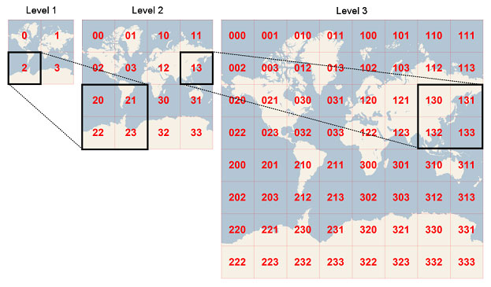
Background
The Bing Maps Tile System uses the Mercator projection and divides the world map into 4 quadrants
At each additional level, each quadrant divides into 4 additional quadrants

Slide 4
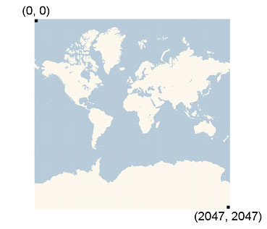
Background
Each tile is 256 by 256 pixels, regardless of the level
For example, at level 3, the map is 8 by 8 tiles for a total of 2048 by 2048 pixels

Slide 5
Approach
The first step is to convert each lat/long coordinate into the pixel position on the maximum resolution image map
The second step is to convert the pixel position into the tile position
The third step is to convert the tile position into a quadrant key
The fourth step is to download all images in the bounding box using its quadrant keys
The last step is to stitch all tile images into one image

Slide 6
Approach
The image from stitching all tiles together will be bigger than the bounding box
To crop the image to the correct bounding box, we can use the pixel position that was calculated earlier as an offset
On the next slide is an example of the crop
The two red dots are the lat/long coordinates for the bounding box
The blue lines indicate different tiles

Slide 7
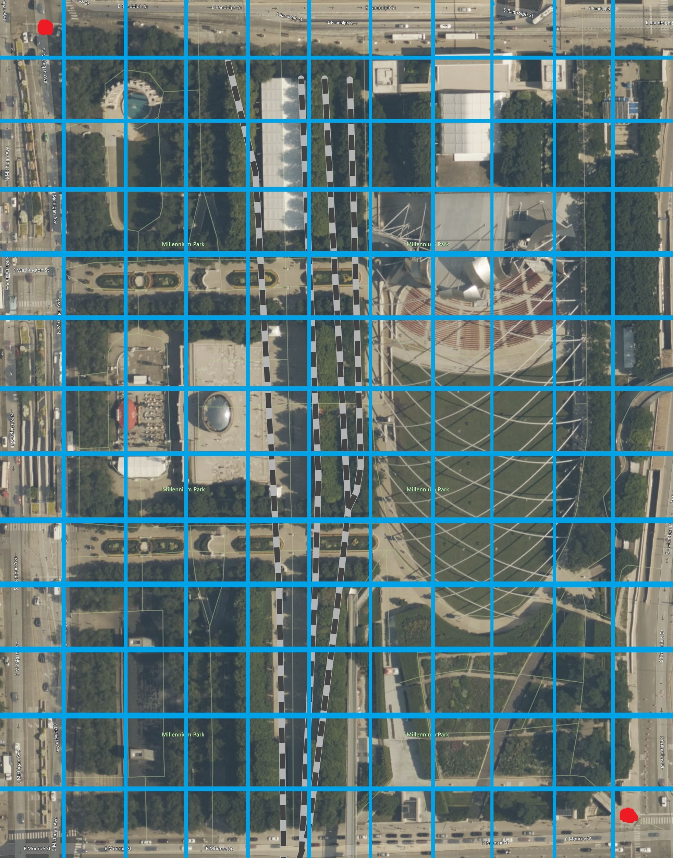
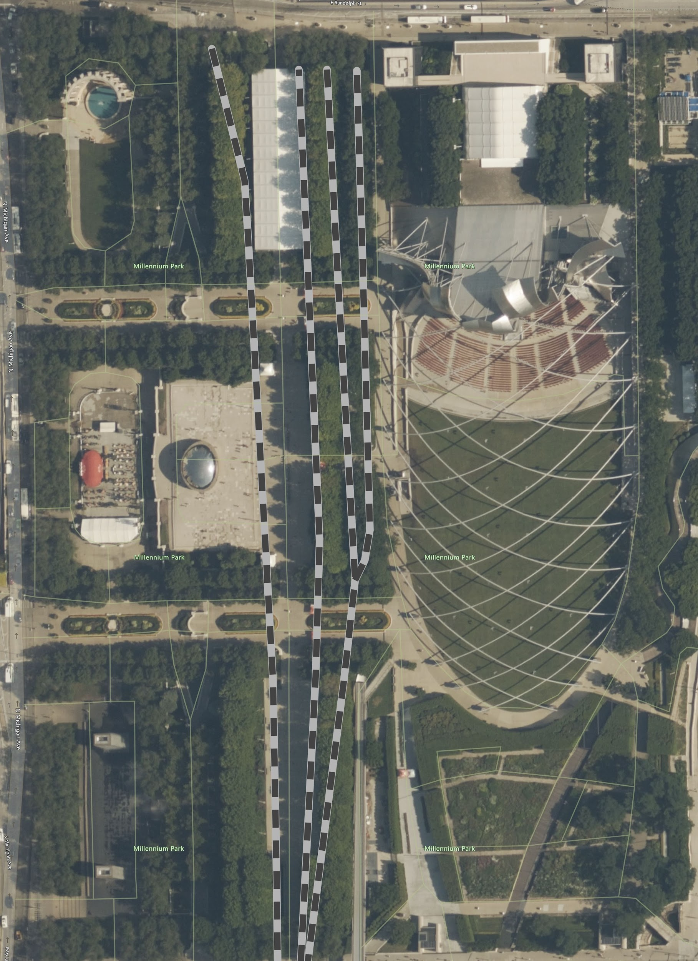
Approach
Before Cropping
After Cropping

Slide 8
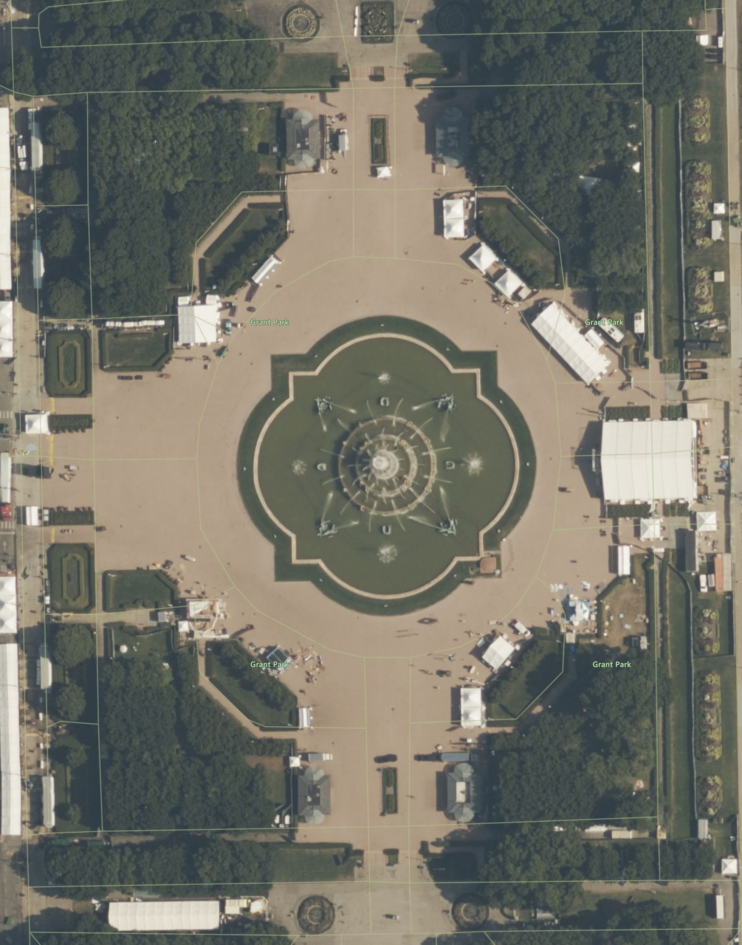
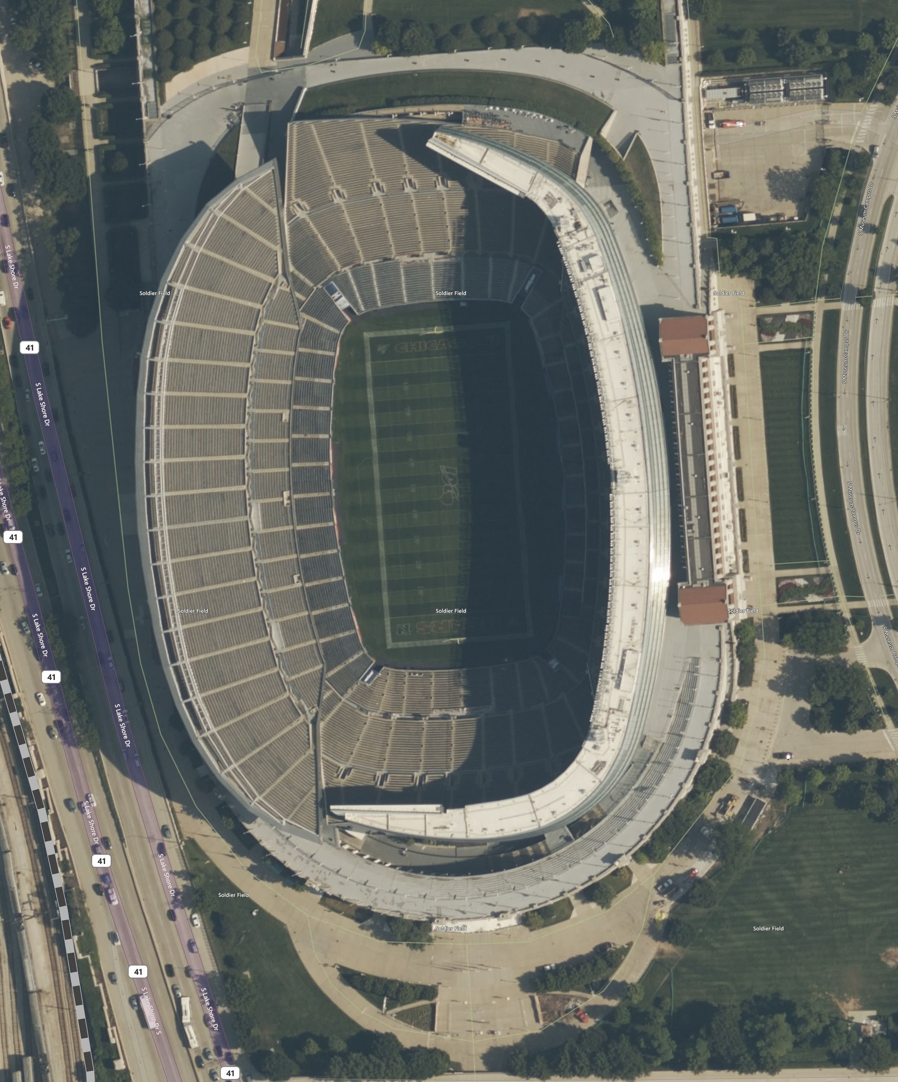
Results
Buckingham Fountain
Cloud Gate (The Bean)
Soldier Field
41.87715, -87.62041
41.87441, -87.61754
41.88429, -87.62421
41.88095, -87.62099
41.86386, -87.61861
41.86037, -87.61472

Slide 9
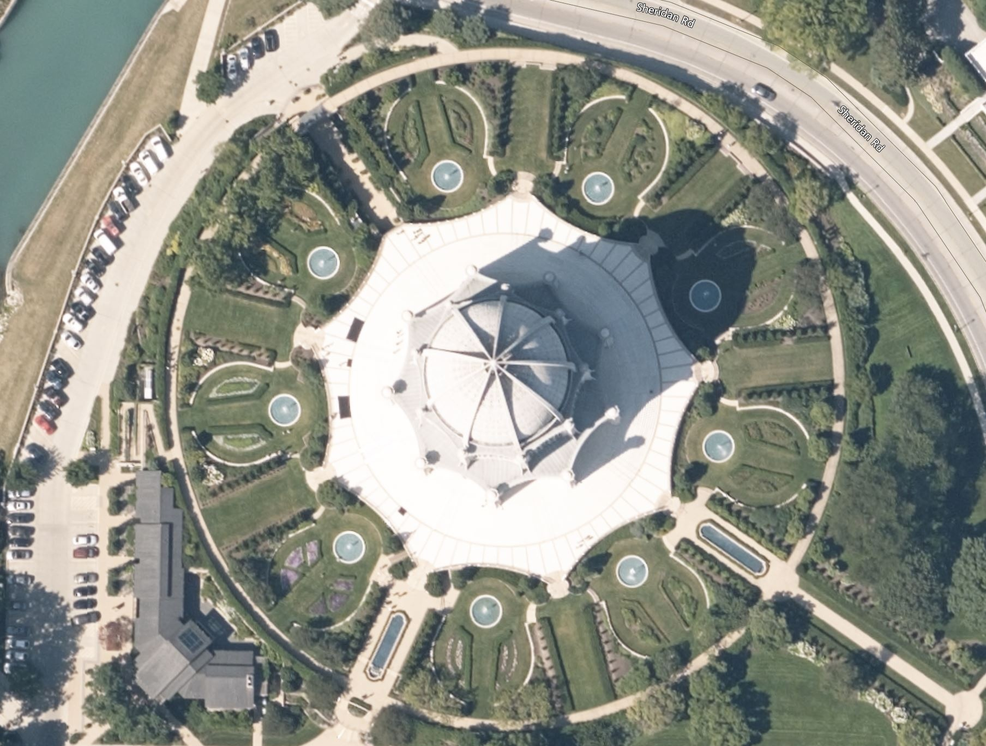
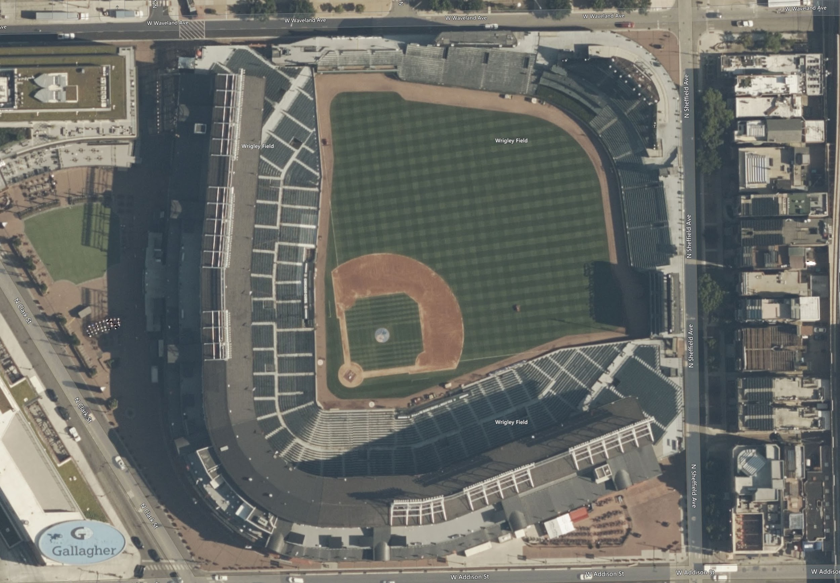
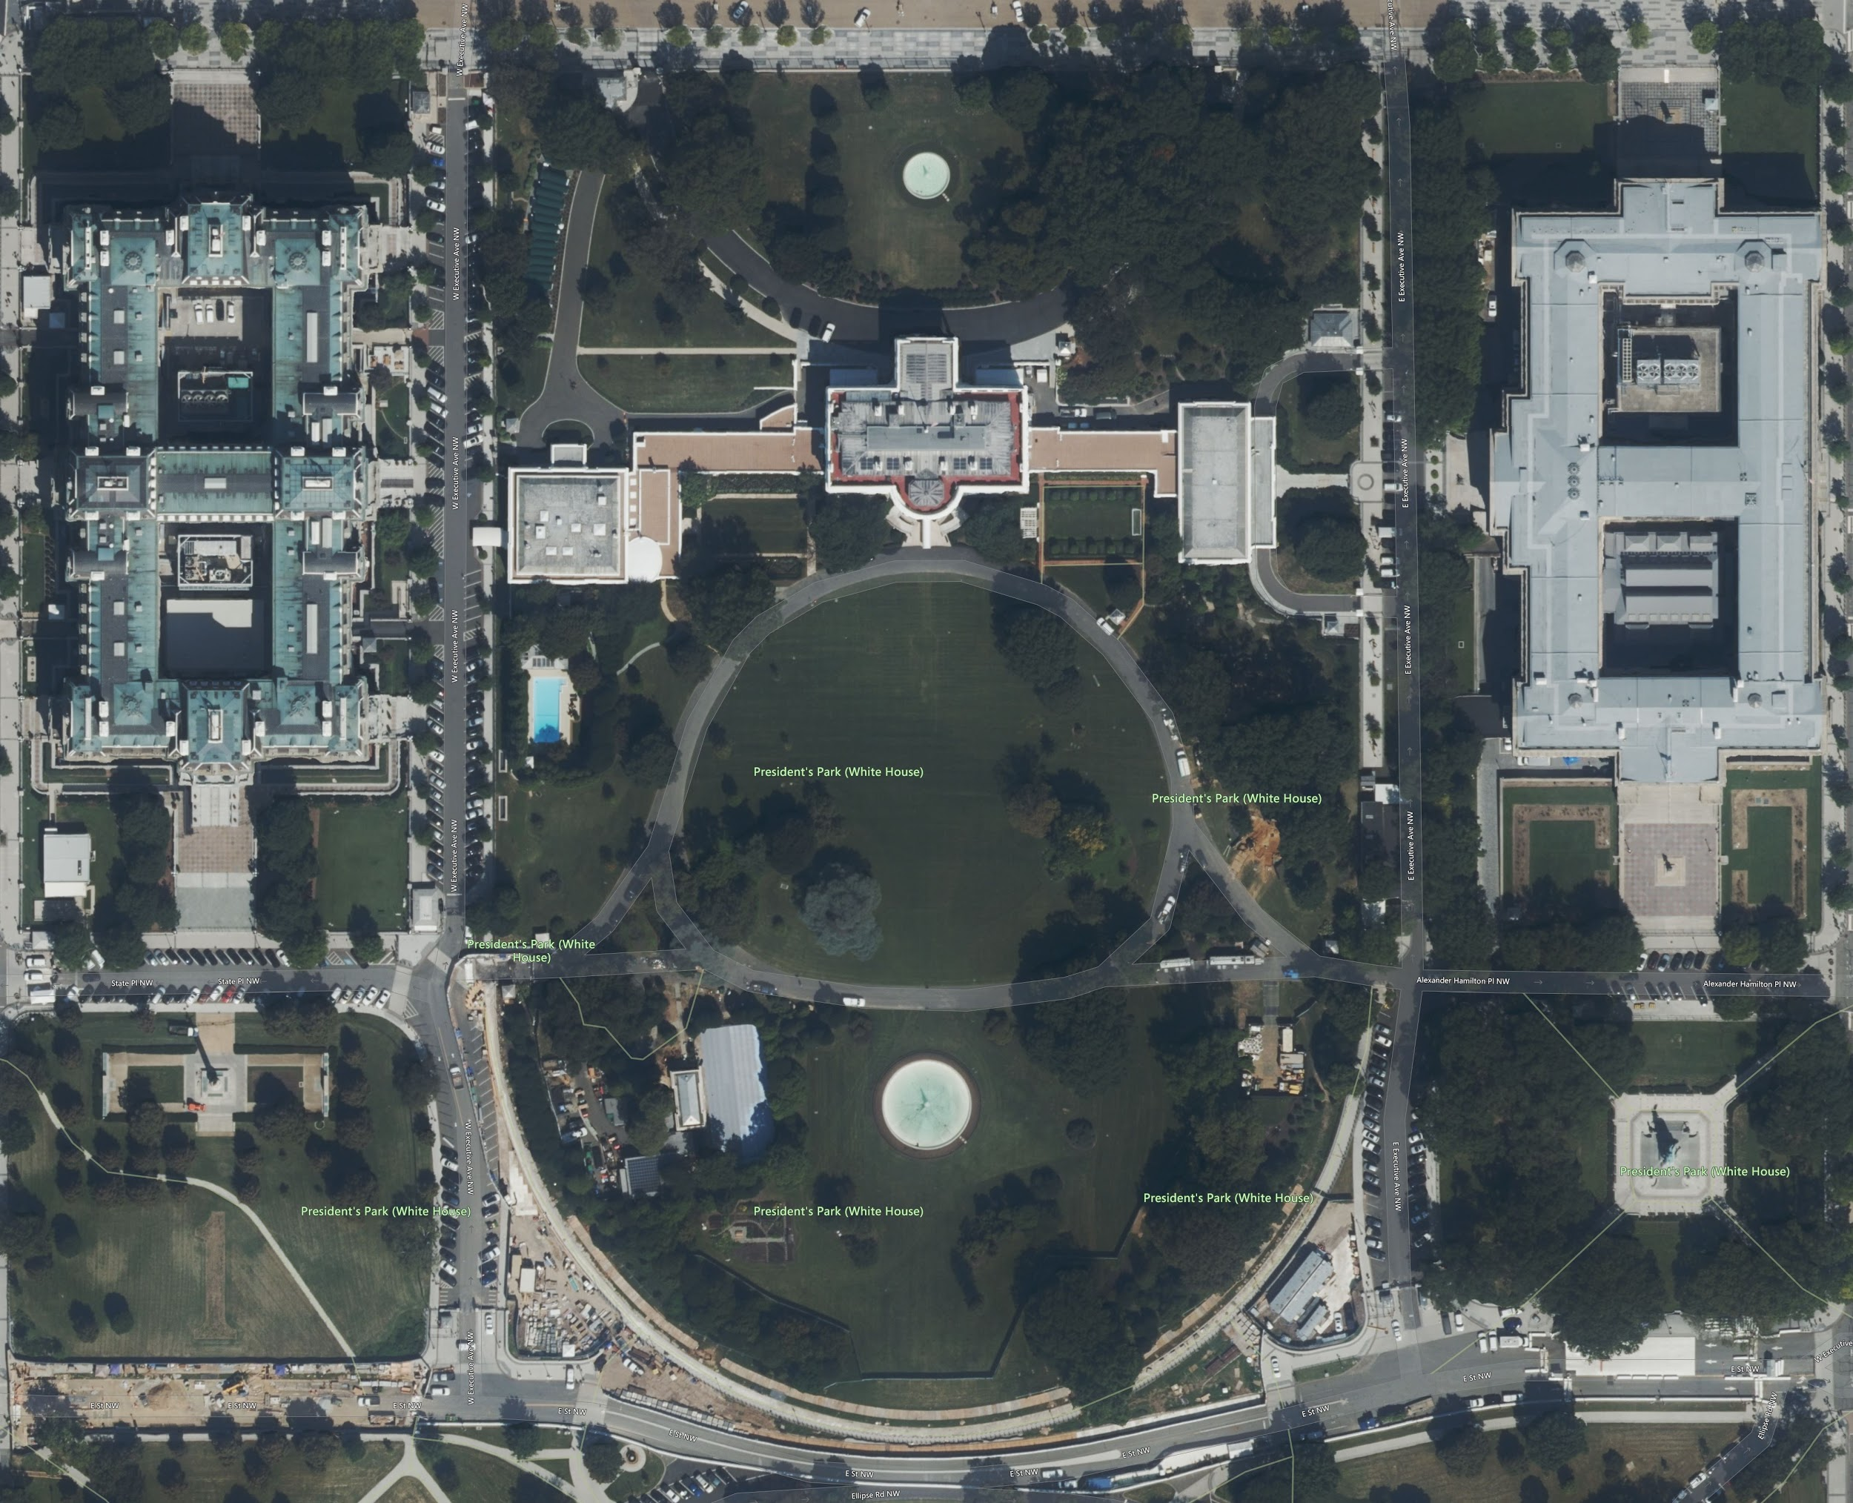
Results
Bahá'í House of Worship
Wrigley Field
White House
42.07515, -87.68553
42.07379, -87.68311
41.94910, -87.65732
41.94723, -87.65369
38.89872, -77.03937
38.89517, -77.03375

Slide 10
Conclusion
Bing Map Tile System allows us to convert lat/long coordinates into tile quadrant keys
Quadrant keys can be used to download specific tile images
The Bing Map Tile System allows us to find a pixel offset of where a lat/long coordinate is on a tile
This offset can help us crop the final stitched image to perfectly match the bounding box

Slide 11
References
Bing Maps Tile System Documentation https://docs.microsoft.com/en-us/bingmaps/articles/bing-maps-tile-system

